Slide 1
NC Department of Health and Human Services
Welcome to
69th Annual TB/RD and
38th SETC Conference
October 5-6, 2021 1pm to 5pm

Slide 2
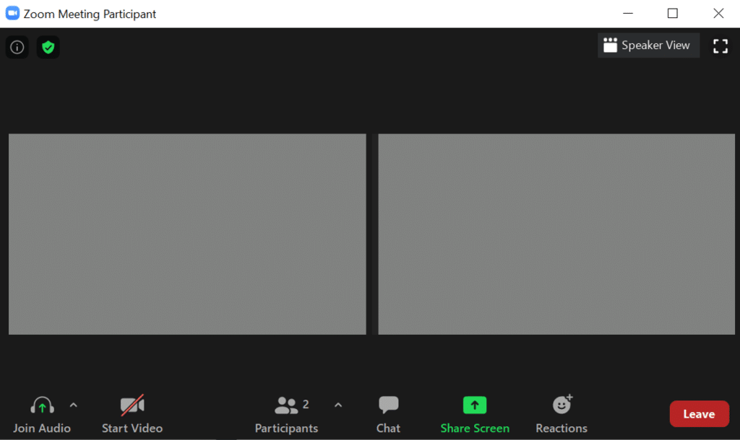
Introduction to Zoom Functions
Notes:
Want to rename yourself, choose a virtual background, or add a profile picture? Right click on your Zoom box.
Let’s practice muting and unmuting ourselves. You should have arrived with your audio muted. Click the carot next to mute button to unmute yourself. On the count of 3, let’s all say good morning. 1 – 2 - 3. good morning! Ok, go ahead and mute yourself!
Let’s practice turning our video on and off. We encourage you to turn off your video when you think your background will be distracting to others, but turn on your video during breakout groups and class discussions. OK, on the count of 3 let’s start our video! And let’s do that again and I’ll take a picture of all of us.
Participants allows you to see who else is in the course. You can send a chat to a specific person or to the entire group. Please feel free to use the chat to make comments and ask questions, though make sure it’s relevant to the course.
Chat allows you to turn on chat. Let’s try it out. Click the chat button, and let us know your favorite song or your favorite musician.
Next is Share screen. You may want to share your screen during breakout sessions, but you probably won’t be sharing your screen in the main room.
Live transcript is an automatic captioning of spoken text. This is an accessibility feature. If you find it helpful, you can leave it on. If you find it distracting, you can click the carrot next to the screen and click Hide Subtitle.
Next is reactions. Let’s try this one out. [Next slide]

Slide 3
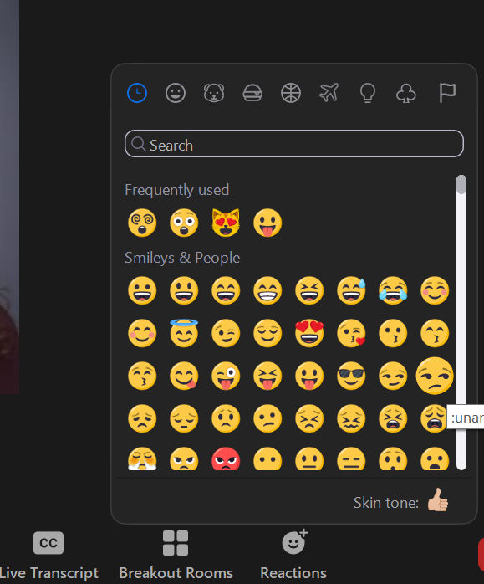
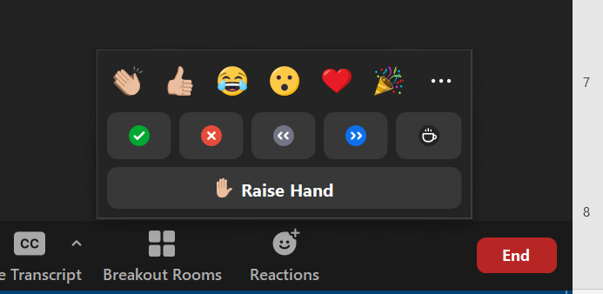
Zoom Reactions: How are you feeling?
Quick Take
Deep Cut
Select Reactions in bottom of Zoom toolbar
Wave, thumbs up, laugh, wow, heart, celebrate
Select Reactions in bottom of Zoom toolbar
Select Meatballs menu (3 dots)
Notes:
On the Zoom toolbar, there are some quick reactions. Once you find these, can you give me a thumbs up to let me know?
Now let’s do a deeper dive on the emojis you can select. Select Reactions again, but then click the meatball (the 3 dots) and select an emoji that captures how you feel? A dragon? A manicure?

Slide 4
NC Department of Health and Human Services
Welcome to
69th Annual TB/RD and
38th SETC Conference
We will be back on the top of the hour!

Slide 5
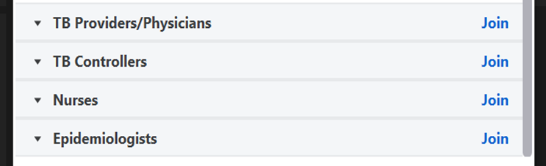
Select a Breakout Room
When breakout rooms begin, a screen will pop up and you will have the ability to join a breakout room (see below).
If you are unable to select join because you called in, a conference organizer will ask which room you would like to be placed in.

